Slide 1
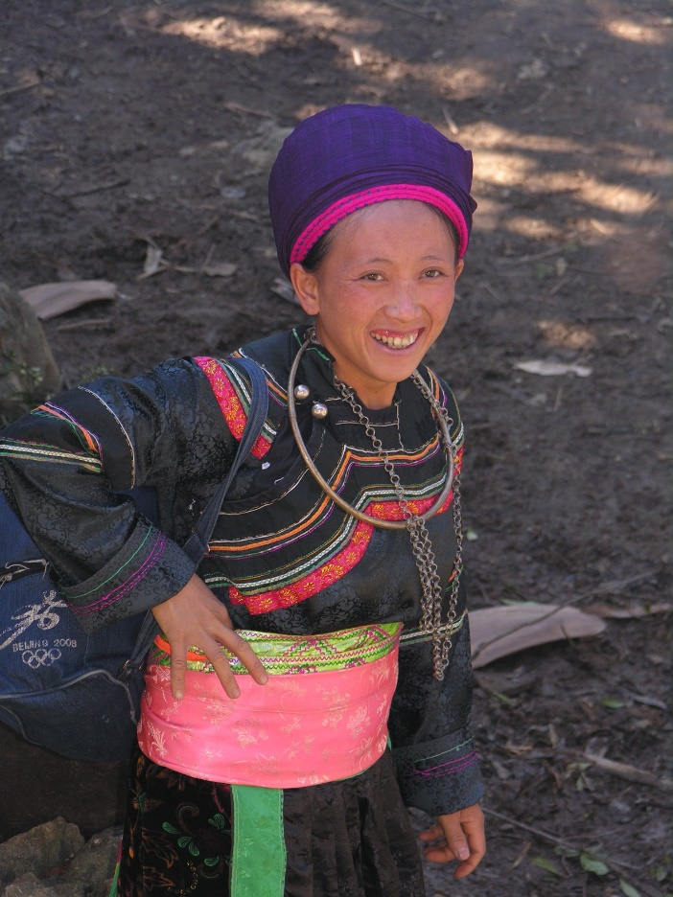
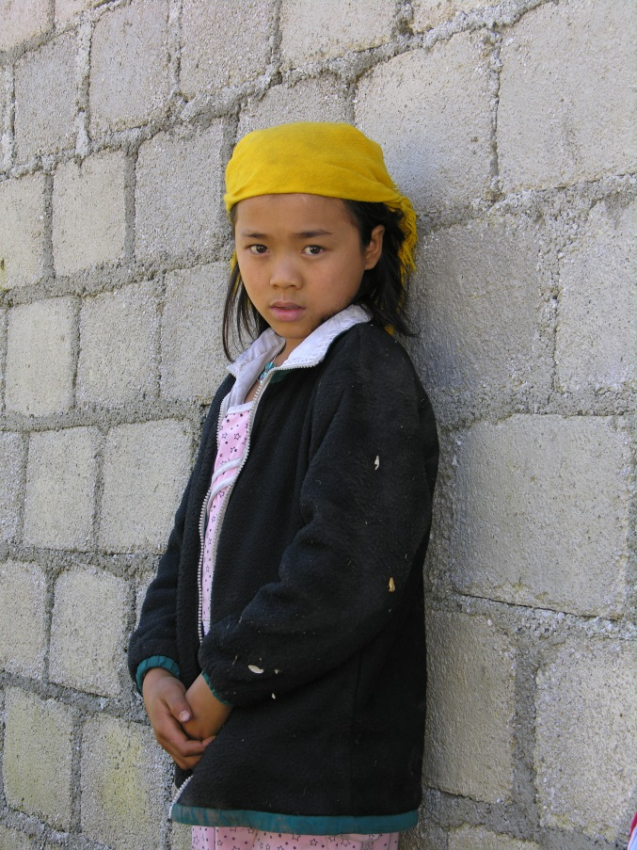
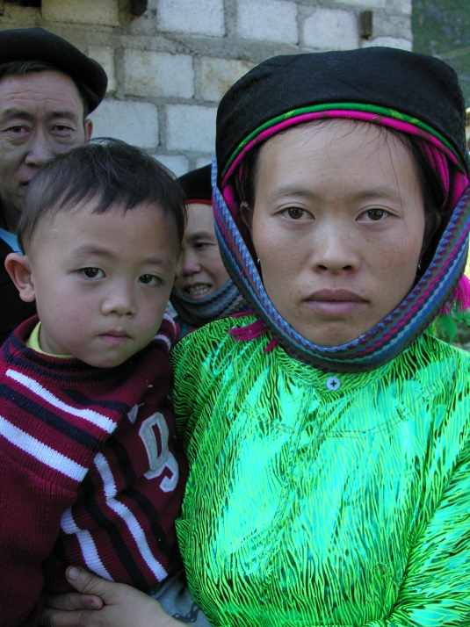
Коллоквиум
«Судьба языкового наследия: передано младшим поколениям или утрачено?»
Институт языкознания РАН. 26.05.2021. (Онлайн)
Ирина Владимировна Самарина
Институт языкознания РАН
НИУ ВШЭ
Малочисленные народы Вьетнама: ситуация с передачей этнических языков младшим поколениям

Slide 2
Pham Quynh (1892 - 1945), writer and mandarin of the Nguyen Dynasty (Vietnam) has a famous saying:
“Truyện Kiều còn, tiếng ta còn; Tiếng ta còn, nước ta còn...”.
“The Tale of Kiều still exists, our language still exists; Our language still exists, our country still exists”.*
* The Tale of Kiều is an epic poem in Vietnamese written by Nguyễn Du (1765–1820), considered the most famous poem and a classic in Vietnamese literature

Slide 3
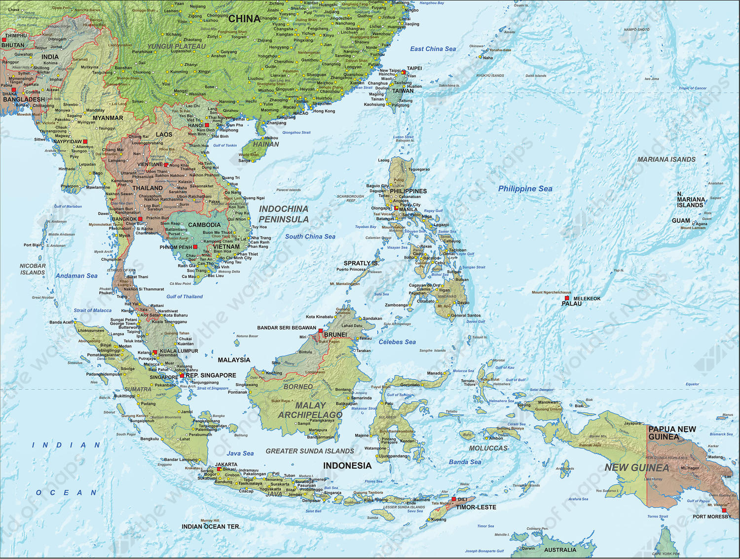
Southeast Asia
Mainland Southeast Asia (Indochina)
• Cambodia
• Laos
• Thailand
• Vietnam
• Myanmar
• Peninsular Malaysia
Maritime Southeast Asia
(Nusantara)
• Brunei
• East Timor
• Indonesia
• Philippine
• Singapore
Andaman and Nicobar Islands (India)

Slide 4
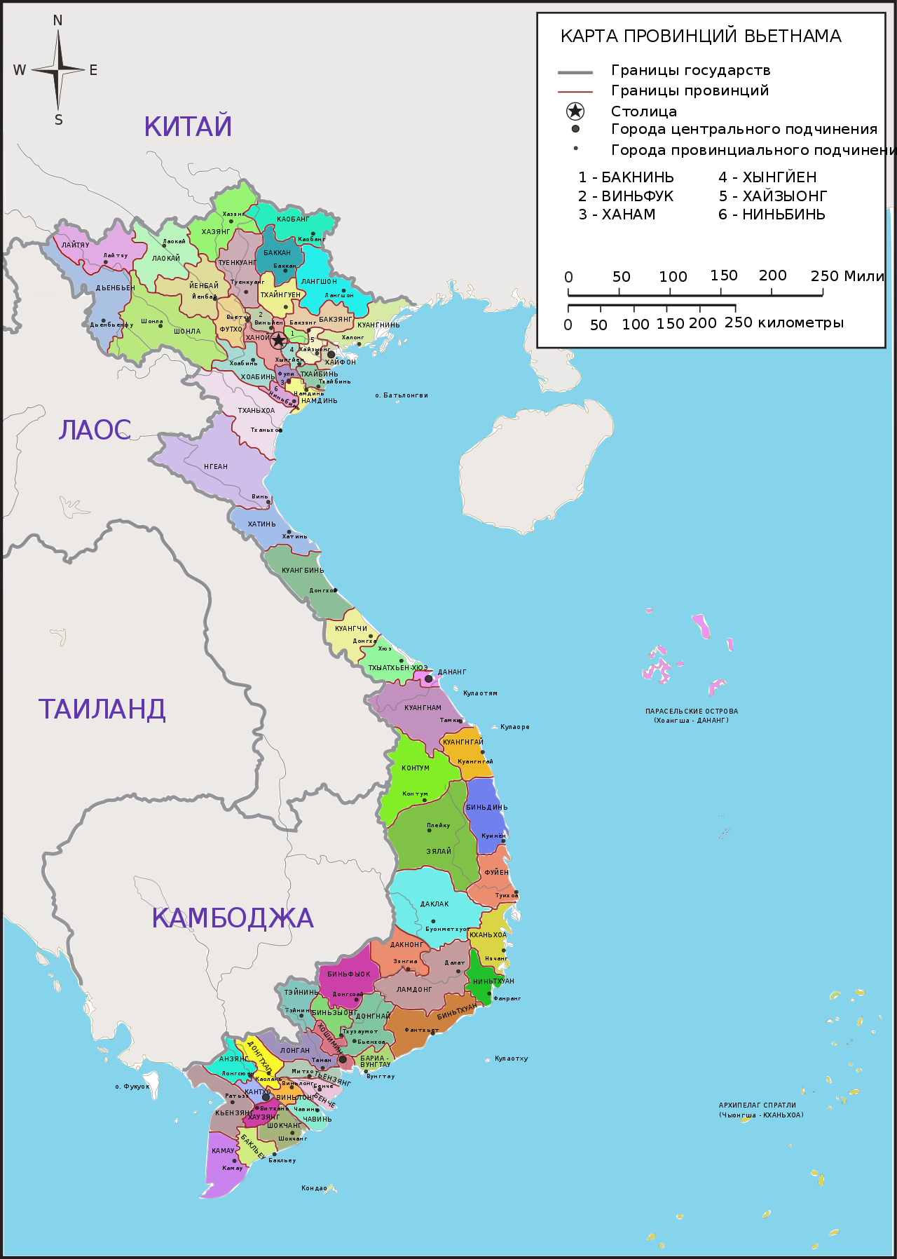
VIETNAM is a multiethnic and multilanguage state.
As for population Vietnam takes the 14th place in the world.
According to the Government’s decree (1979), there are 54 recognized ethnic groups in Vietnam: Kinh (ethnic Vietnamese) and 53 ethnic minorities.
Their languages belong to five families of Southeast Asia:
Austroasiatic
Tai-Kadai
Hmong-Mien
Sino-Tibetan
Austronesian
There is great diversity in Vietnam’s ethnic groups.
The Hoa (ethnic Chinese) is very well assimilated into Vietnamese culture.
Others, such as the Hmong and Nung peoples, have agrarian livelihoods and remain strongly culturally connected to forests.

Slide 5
Census 2020
 | Population (%)
Kinh (ethnic Vietnamese) | 85,3
Ethnic minorities | 14,7
0–14 years | 23.55%
15–64 years | 70.33%
65 and over | 6.12%
 | Countryside | City
Total | 66,1% | 33,9%
Ethnic minorities | 89,3% | 10,7%
Ethnic minorities are concentrated in the mountainous and rural regions of Vietnam but have also scattered throughout Vietnam due to war and migration.
Ethnic minorities living in urban areas are more affluent than the same ethnic minority groups living in rural areas.
Many communes and villages have 3-4 different ethnic groups living side by side.
Geography plays a major part in the cultural practices of many ethnic minorities but also negatively impacts access to infrastructure and services like health care and education.
Source: Survey 53 ethnic minorities in 2015, Committee for Ethnic Minority Affairs

Slide 6
No. | Ehnic group | Family | Literacy rate 2015 | Census 2019 | Census 2009 |  | No. | Ehnic group | Family | Literacy rate 2015 | Census 2019 | Census 2009
1 | La Hu | Tibeto-Burman | 34.60% | 12133 | 9651 |  | 28 | Co Ho | Austroasiatic | 72.30% | 200800 | 166112
2 | Lu | Tai-Kadai | 42.80% | 6757 | 5601 |  | 29 | E De | Austronesian | 72.40% | 398671 | 331194
3 | Mang | Austroasiatic | 43.80% | 4650 | 3700 |  | 30 | Pa Then | Hmong-Mien | 72.60% | 8248 | 6811
4 | Brau | Austroasiatic | 48.20% | 525 | 397 |  | 31 | Xo Ðang | Austroasiatic | 72.70% | 212277 | 169501
5 | H'Mong | Hmong-Mien | 48.60% | 1393547 | 1068189 |  | 32 | Bo Y | Tai-Kadai | 72.70% | 3232 | 2273
6 | Co Lao | Tai-Kadai | 49.80% | 4003 | 2636 |  | 33 | Mnong | Austroasiatic | 72.90% | 127334 | 102741
7 | Ha Nhi | Tibeto-Burman | 50.60% | 25539 | 21725 |  | 34 | Co | Austroasiatic | 73.00% | 40442 | 33817
8 | Lo Lo | Tibeto-Burman | 54.50% | 4827 | 4541 |  | 35 | Ta Oi | Austroasiatic | 74.10% | 52356 | 43886
9 | Raglay | Austronesian | 54.90% | 146613 | 122245 |  | 36 | Ro Mam | Austroasiatic | 74.10% | 639 | 436
10 | La Chi | Tai-Kadai | 57.00% | 15126 | 13158 |  | 37 | Cho Ro | Austroasiatic | 74.40% | 29520 | 26855
11 | La Ha | Tai-Kadai | 57.50% | 10157 | 8177 |  | 38 | Khmer | Austroasiatic | 74.50% | 1319652 | 1260640
12 | Gia Rai | Austronesian | 59.10% | 513930 | 411275 |  | 39 | Co Tu | Austroasiatic | 75.10% | 74173 | 61588
13 | Xtieng | Austroasiatic | 60.70% | 100752 | 85436 |  | 40 | Gie Trieng | Austroasiatic | 75.70% | 52000 | 50962
14 | Kho Mu | Austroasiatic | 61.60% | 90612 | 72929 |  | 41 | Pu Peo | Tai-Kadai | 75.80% | 903 | 687
15 | Khang | Austroasiatic | 62.40% | 16180 | 13840 |  | 42 | Giay | Tai-Kadai | 76.20% | 67858 | 58617
16 | Chut | Austroasiatic | 63.00% | 7513 | 6022 |  | 43 | Cham | Austronesian | 79.70% | 178948 | 161729
17 | Bru Van Kieu | Austroasiatic | 63.30% | 94598 | 74506 |  | 44 | Thai | Tai-Kadai | 81.30% | 1820950 | 1626392
18 | Lao | Tai-Kadai | 63.50% | 17532 | 14928 |  | 45 | Nung | Tai-Kadai | 89.00% | 1083298 | 968800
19 | Si La | Tibeto-Burman | 63.70% | 909 | 709 |  | 46 | San Chay | Tibeto-Burman | 89.40% | 201398 | 169410
20 | Ba Na | Austroasiatic | 63.90% | 286910 | 227716 |  | 47 | O Du | Austroasiatic | 91.90% | 428 | 376
21 | Xinh Mun | Austroasiatic | 64.00% | 29503 | 23278 |  | 48 | Hoa | Sino-Tibetan | 92.00% | 749466 | 751067
22 | Hre | Austroasiatic | 64.70% | 149460 | 127420 |  | 49 | Ngai | Sino-Tibetan | 92.10% | 1649 | 1035
23 | Cong | Tibeto-Burman | 67.20% | 2729 | 2029 |  | 50 | San Diu | Sino-Tibetan | 94.90% | 183004 | 146821
24 | Ma | Austroasiatic | 68.60% | 50322 | 41405 |  | 51 | Tay | Tai-Kadai | 95.00% | 1845492 | 1550423
25 | Dao | Hmong-Mien | 70.50% | 891151 | 823071 |  | 52 | Muong | Austroasiatic | 95.00% | 1452095 | 1268963
26 | Chu Ru | Austronesian | 71.30% | 23242 | 19314 |  | 53 | Tho | Austroasiatic | 95.00% | 91430 | 74458
27 | Phu La | Tibeto-Burman | 71.60% | 12471 | 10944
96% of ethnic minorities speak their mother tongue.
Sources:
Research Center for Human Rights of Ethnic Minority and Mountainous People (HRC) 2015
Completed Results of the 2019 Vietnam Population and Housing Census. 2020
The 2009 Vietnam Population and Housing Census. 2010.

Slide 7
The disappearance and loss of traditional cultural identities of ethnic minorities are happening in many different dimensions, especially for the 16 smallest ethnic groups by population:
Si La, O Du, Brau, Ro Mam, Pu Peo (under 1,000 people),
Cong, Mang, Bo Y, Lo Lo, Co Lao, Ngai (under 5,000 people),
Lu, Pa Then, Chut, La Ha, La Hu (under 10,000 people).
Nowadays, many ethnic groups no longer speak their own language.
Bo Y people belong to 2 local groups, Tu Di (Lao Cai) and Bo Y (Ha Giang). Currently, the Bo Y people in Lao Cai do not remember their mother tongue, now speak Mandarin (Southern Chinese), while the Bo Y people in Ha Giang mainly speak Giay and Tay.
Phu La, there are 2 branches: Pu La and Xa Pho. The Xa Pho people still retain their mother tongue, but the Pu La people cannot speak their mother tongue and also use Mandarin.
Some ethnic minorities such as Khang, La Ha, Xinh Mun ... no longer use their own language to communicate. They use mainly Thai language. Even the folk songs of the Khang people, the Xinh Mun people, 70 - 80% are in Thai.
The O Du ethnic group (430 people) in Tuong Duong district (Nghe An), also use the Thai or Vietnamese languages.

Slide 8
The party, state, society.
In the situation of a market economy and international integration, the danger of the disappearance of the languages of ethnic minorities is increasing.
On the part of society, a line of protection and preservation of the languages and cultures of small peoples should also be built.
To preserve the languages of ethnic minorities, it is necessary
to develop laws on languages,
teaching languages of ethnic minorities
learning languages of ethnic minorities
The basic principle of the policy pursued by the Communist Party and the government of Vietnam in relation to ethnic minorities:
"Equality, solidarity, respect and help for mutual progress“
(“Bình đẳng, đoàn kết, tôn trọng, giúp đỡ nhau cùng tiến bộ”)

Slide 9
The Constitution and legal documents
Article 42 of the Constitution (2013), the right to use and access language is mentioned as follows:
“Citizens have the right to define their own ethnicity, to use their mother language. to choose the language of communication”.
Article 5 of the 2013 Constitution states:
"All ethnic groups have the right to use their own language and script, preserve their national identity, and promote their fine customs, practices, traditions and culture";
The Law on Education 2005: “The State creates conditions for ethnic minorities to learn their own language and writing system to preserve and promote their cultural identity, helping ethnic minority students easily absorb knowledge while learning in schools and other educational institutions. ”
The 2014 Law on Organization of People's Courts: “The spoken and written language used before the Court is Vietnamese. The Court guarantees procedure participants the right to use their own language and script before the People's Court. In this case, there must be an interpreter ”.

Slide 10
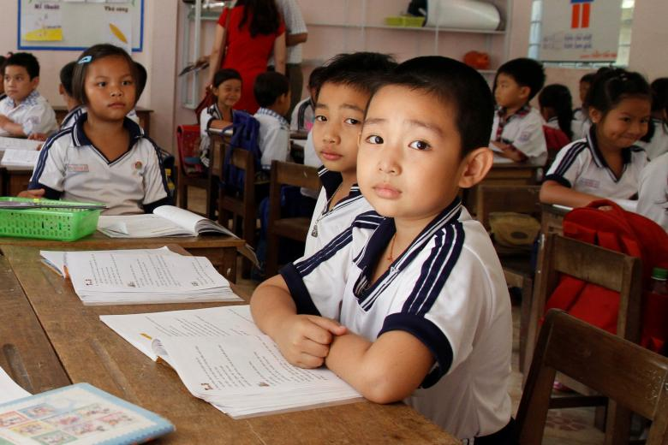
Pre-school | Optional (not compulsory) for children aged between 18 months and five years old Fees may be payable More commonly found in major cities
Primary School | Compulsory from age six to 11 for all children Education at the primary level is free
Secondary School | Secondary education is divided into lower and upper programmes Not compulsory
Vietnam recognizes education as a national priority. Since 2008, the government has been spending about 6% of its budget on education. The government’s strong commitment to education and long-standing cultural and social support for education has led to significant progress in the sector.
Despite these achievements, the country still faces some challenges. Access and quality are still concerns for lower secondary education and quality is limited in remote areas. Accessing and completing education is a greater challenge for female students and ethnic minorities.
There are some fairly low fees charged for education under the state system, for books and contributions for school equipment, as well as additional costs for uniforms, transport, and school materials.
Less than five percent of the population has never been to school.
The Party and Government have focused on education in ethnic minorities’ areas.
The education level of the ethnic minorities is still limited

Slide 11
1. Children at home are accustomed to speaking their mother tongue, so the development of skills speaking Vietnamese is limited. For ethnic minorities, the question of what to do is a matter directly related to the family's decision to send their children to school or not. Only when people see the benefits of education they will be determined to let their children go to school.
National target programme on sustainable poverty reduction
The poverty rate among ethnic minority groups is still high.
Over the last decade, the Vietnamese government has allocated resources to economic development and poverty reduction in ethnic communities. The number of poor households in ethnic areas has decreased 2 to 3% annually.
Strengthening Vietnamese language for preschool children, elementary school students in ethnic minority areas
2. Children are speaking Vietnamese at home
Teaching and learning ethnic minorities languages in school
Bilingual education

Slide 12
The story of Dr. Ban Thi Quynh Dao (Institute of Literature)
Dr. Quynh Dao has a Zao Tien father and a Kinh mother.
Her father was the first Dao to have a Ph.D. in the Soviet Union, fluent in Russian and Chinese, but still did not forget his Zao language.
But in the turn of Mrs. Quynh Dao and her brothers, everything changed.
Living among the Kinh people, she and her brothers dare not speak the Zao language because “they are afraid that everyone will recognize themselves as an ethnic minority".
The generation of Zao people "escaped" from the village like the Zao family did, but even in the Zao community in the middle of the village, few people can read and know Nom Zao anymore.
Mrs. Quynh Dao said that even the priests and shamans but could not read or write Zao.
Each locality has ethnic boarding schools, but the ethnic language teaching here is not respected.
Deputy Minister of Culture, Sports and Tourism Trinh Thi Thuy.
Father is Kinh, mother is Muong.
Due to her living environment and work, Ms. Thuy has very little chance of speaking her mother tongue. However, she worries that even though her relatives are 100% Muong and still living in the village, there are fewer and fewer who speak the Muong language, because the children who go to school after a while will change to speak Kinh language with their parents.

Slide 13
Decree No. 82/2010 / ND-CP of the Government regulates the teaching and learning of the languages and scripts of ethnic minorities in education
The project of preserving and developing Vietnamese cultures up to 2020 also focused on developing and encouraging ethnic minority people to use ethnic languages.
Languages of ethnic minorities
are using as means of teaching and learning in some schools in ethnic minority areas (Dak Lak, Gia Lai, Kon Tum, Lam Dong, Dak Nong ...provinces ).
​​are using on local radio and television stations (Khmer, Ede, Gia Rai, Ba Na, Cham, H’Mong, Thai, Xo Dang, Tay, Ha Nhi, Hre, Ka Tu ...)
are using to compile bilingual dictionaries, grammars, textbooks
there are some ethnic minority languages ​​and scripts used in the mass media from central to local levels, such as: Tay, Thai, Dao, Mong, Gia Rai, Ede, Ba Na, Cham, Khmer ...
Among the ethnic minorities in Vietnam, about 30 ethnic minorities have their own writing system, some even have more than one writing system.
Some writing systems have a long history (Khmer, Thai, Cham, Tay, Nung, Dao ...)
Ancient Thai, Cham, Khmer scripts are based on Sanskrit.
The ancient scripts of the Tay, Nung, Cao Lan, Dao are originating from the Han script, having a tradition of several centuries.
Many writing systems have been developed recently based on the Latin script.
Some scripts were created before 1945 (Ba Na, Gia Rai, Ede, Koho), but some other Latin scripts were created after 1960 and later.

Slide 14
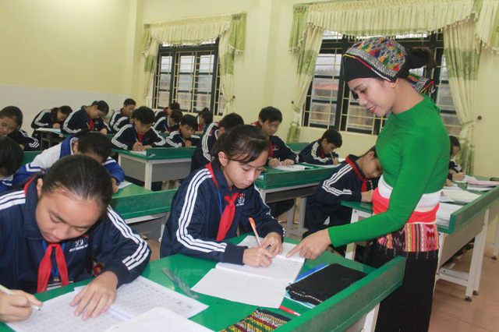
2017
Ethnic Minority Boarding School in Thanh Hoa province has opened classes to teach the Thai language and writing to grade 8 students.
Most of the school's students are of Thai ethnicity, but many do not speak and understand their own language.
The reason is that their parents did not teach their children the Thai language but only spoke Vietnamese. When they went to elementary school, they mostly spoke Vietnamese, so the Thai language was lost.
Decree No. 82/2010 / ND-CP of the Government regulating the teaching and learning of ethnic minority languages ​​in schools

Slide 15
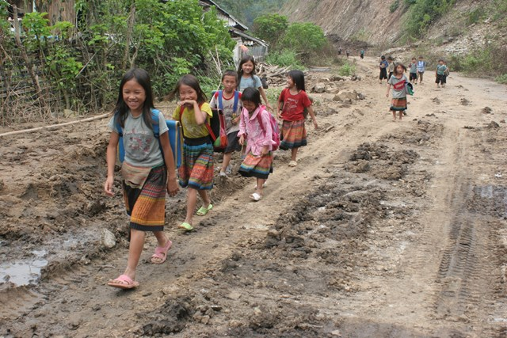
Bilingual education based on mother tongue.
The Ministry of Education and Training suggested using 8 ethnic languages ​​(including Thai, Mong, Ba Na, Gia Rai, Xo Dang, Cham, Khmer, Hoa, Ede) for elementary and secondary boarding schools for ethnic minorities. About 30 provinces and cities are organizing the teaching of ethnic minority languages ​​in schools.
Pilot project
In Lai Chau province was conducted three years project (2016-2018), sponsored by the European Union. Tam Duong district of Lai Chau province is home to many ethnic minority groups such as Dao, Thai, and H’Mong.
- Education based on the native language of students
- Active participation of parents and children in educational activities is supposed.
Problems:
- Compiling school books for children (a set of bilingual supplementary educational materials in Vietnamese and Mong languages)
- Lacking ethnic language teachers.
No schools across the country have established a faculty to train teachers of ethnic minority languages…

Slide 16
Decision No. 1008 / QD-TTg dated June 2, 2016 of the Prime Minister approving the project “Strengthening Vietnamese language for preschool children, elementary school students in ethnic minority areas in period 2016 – 2020, with orientation to 2025.”
The second phase of the project (2021 - 2025)
For ethnic minority children preparing to enter grade 1
It is necessary to continue promoting propaganda and mobilization of ethnic minority families to create conditions for children to go to school and study 2 sessions/day
Project to raise awareness and responsibility of the Party committees, local authorities at all levels, parents, students, and ministries, teachers, and communities for enhancing Vietnamese language for ethnic minority children:
Develop and implement columns and special pages in the mass media to support young parents and the community in enhancing the Vietnamese language for children/
Propagate and support parents in enhancing the Vietnamese language for children, building a Vietnamese environment in families and communities. Mobilizing ethnic minority families to create conditions for their children to go to school, class, and study 2 times/day, ensuring diligence.

Slide 17
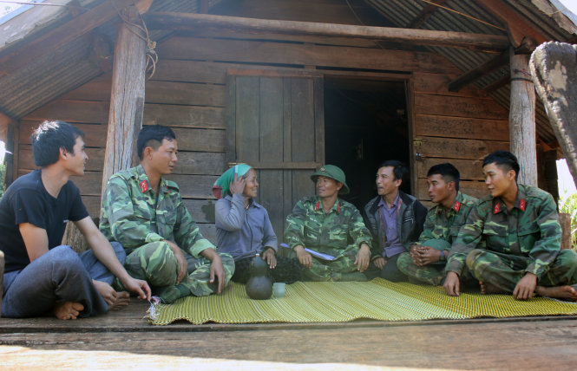
Mobilizing border guard officers and soldiers to teach Vietnamese to the parents of children who are ethnic minorities; retired cadres, members, and union members of political and social organizations participated in supporting to strengthen Vietnamese language for ethnic minorities' parents and children.
“Eat together, live together, work together and speak together, using the language of the local people” (border guards and military, Gia Lai province, 2017)
Their mission is to chat with the ethnic minorities, keep the society safe, teach the basics of hygiene, introduce modern life.

Slide 18
The number of preschool children that need to be strengthened in Vietnamese is rather big.
Raglai ethnic group.
When children go to school, they only speak their mother tongue.
Khanh Vinh district (Khanh Hoa province)
In preschools, more than 68% of children are ethnic minorities
Primary schools have more than 81% of ethnic minority students.
Quảng Ninh 2019
Now preparing for the new school year, since the summer, many classes are organized to strengthen the Vietnamese language for children of ethnic minorities, helping them to get ready to go to school.
Khanh Vinh district (Khanh Hoa province) preschools organize strengthening Vietnamese for ethnic minority children from 3 to 5 years old.
However, this work still has certain difficulties
Many children have parents who regularly go to the fields
Nearly 80% of teachers in ethnic minority areas are Kinh people and are not fluent in their language. The language barrier is limiting communication and reducing the efficiency of Vietnamese language communication between teachers and students.
In recent years, thanks to this project, in general, ethnic minority children entering grade 1 have been able to speak Vietnamese fluently

Slide 19
Thus, the Vietnam situation concerning the transfer of native languages to the younger generation is a mosaic. There are two opposite tendencies:
children at home are accustomed to speaking their mother tongue, so the development of skills speaking Vietnamese is limited;
children are speaking Vietnamese at home;
and many intermediate situations.
The main driving factors are:
improvement in the economic situation in the country,
compulsory primary education,
implementation of a state project to strengthen the Vietnamese language for children of ethnic groups,
an increase in the role of the mass media,
mixed marriages.
Vietnamese language acquisition is viewed by parents now as a necessary condition for the socialization and involvement of children in modern society. Therefore, parents try to ensure that their children learn Vietnamese before school and even change the language(s) of communication in the family to Vietnamese.
Thus, over the past decade, the mother tongue's interruption transmission in the families of ethnic minorities has accelerated significantly.
The preservation of the languages of ethnic minorities has deteriorated significantly.

Slide 20
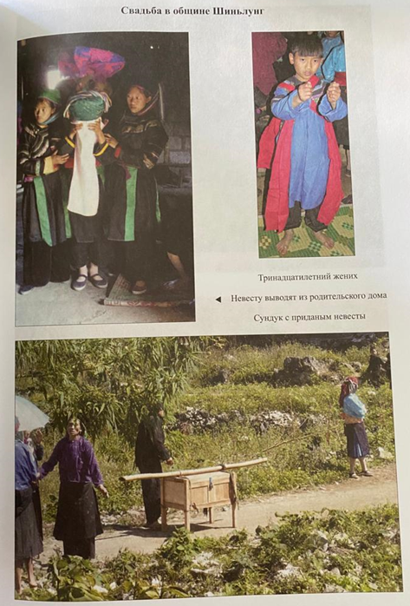
Gelao ethnic minority. Ha Giang Province, Vietnam, 2008.
14-year-old bride and 13-year-old groom. A 14-year-old girl can already work as an adult. Therefore, marriage takes place at such an early age of the bride and a groom. At first, the groom's family will use the girl as a labor force, and in a few years, when the girl and the boy grow up, it will already be a real marriage.

